Slide 1

Electrical and Electronic Engineering Principles 1
UWEBIC IY424
Mohammad Hosseinabady
mohammad@highlevel-synthesis.com

Slide 2
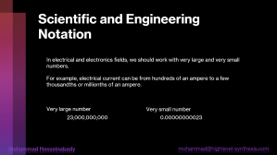
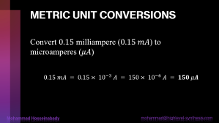

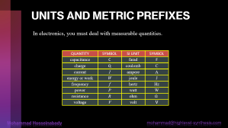
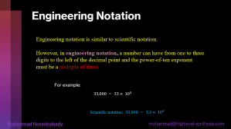
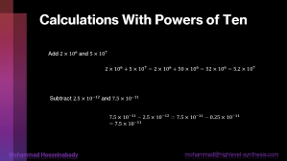
Overview

Slide 3

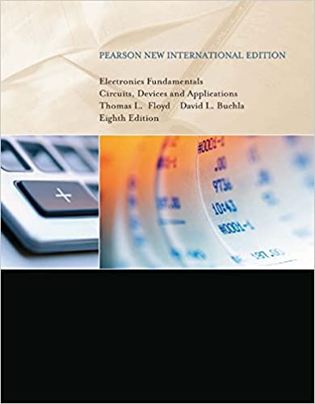

References
Software
Electronics Fundamentals Circuits, Devices and Applications Thomas L. Floyd David L. Buchla Eighth Edition
https://www.multisim.com/

Slide 4
This session
Chapter 1
QUANTITIES AND UNITS

Slide 5
Scientific and Engineering Notation
In electrical and electronics fields, we should work with very large and very small numbers.
For example, electrical current can be from hundreds of an ampere to a few thousandths or millionths of an ampere.
Very large number
Very small number
23,000,000,000
0.00000000023

Slide 6
Two Ways of Notations
Scientific Notation
A quantity is expressed as a product of a number between 1 and 10 and a power of ten.
For example
15000 =
1.5 x 10⁴
0.00015 =
1.5 x 10⁻⁴
Engineering Notation

Slide 7



Quiz
Find the equivalent value
1- ${10}^{6}$
a) 16 b) 1,000,000 c) 6000 d) 0.0000001
2- ${10}^{−4}$
a) 1000 b) 0.0001 c) 0.001 d) 0.00001
3- ${10}^{−6}$
a) 1000 b) 0.000001 c) 0.001 d) 0.00001

Slide 8

Quiz
Express each number in scientific notation:
240
5100
85,000
3,350,000
Solution
$240 = 2.4×{10}^{2}$
$5100=5.1×{10}^{3}$
$85,000=8.5×{10}^{4}$
$3,350,000=3.35×{10}^{6}$

Slide 9

Quiz
Express each number in scientific notation:
0.24
0.005
0.00063
0.000015
Solution
$0.24 = 2.4×{10}^{−1}$
$0.005=5×{10}^{−3}$
$0.00063=6.3×{10}^{−4}$
$0.000015=1.5×{10}^{−5}$

Slide 10


Quiz
Express each of the following numbers as a normal decimal number:
$1×{10}^{5}$
$2.9×{10}^{3}$
$3.2×{10}^{−2}$
$2.5×{10}^{−6}$
Solution
$1×{10}^{5}$ = 100,000
$2.9×{10}^{3}$ = 2900
$3.2×{10}^{−2}$ = 0.032
$2.5×{10}^{−6}$ = 0.0000025

Slide 11



Calculations With Powers of Ten
Add $2×{10}^{6}$ and $5×{10}^{7}$
$$2×{10}^{6}+5×{10}^{7}=2×{10}^{6}+50×{10}^{6}=52×{10}^{6}=5.2×{10}^{7}$$
Subtract $2.5×{10}^{−12}$ and $7.5×{10}^{−11}$
$$7.5×{10}^{−11}−2.5×{10}^{−12}=7.5×{10}^{−11}−0.25×{10}^{−11}=7.5×{10}^{−11}$$

Slide 12



Calculations With Powers of Ten
Multiply $5×{10}^{12}$ by $3×{10}^{−6}$
$$\left(5× {10}^{12}\right)\left(3×{10}^{−6}\right)= 15× {10}^{12+\left(−6\right)} = 15× {10}^{6} = 1.5× 10^{7}$$
Divide $5.0×{10}^{8}$ by $2.5×{10}^{3}$
$$\frac{5.0×{10}^{8}}{2.5×{10}^{3}}=2×{10}^{5}$$

Slide 13


Quiz
Add $4.1× {10}^{3}$and $7.9× {10}^{2}$.
Subtract $3.5× {10}^{−6}$from $2.2× {10}^{−5}$

Slide 14


Quiz
Multiply $1.2× {10}^{3}$ by $4× {10}^{2}$.
Divide $8× {10}^{−6}$ by $2× {10}^{−10}$.

Slide 15

Engineering Notation
Engineering notation is similar to scientific notation.
However, in engineering notation, a number can have from one to three digits to the left of the decimal point and the power-of-ten exponent must be a multiple of three.
For example:
$$33,000 = 33× {10}^{3}$$
Scientific notation: $33,000 = 3.3× {10}^{4}$

Slide 16


Engineering Notation
Example:
$$0.045=45× {10}^{−3}$$
Engineering Notation
$$0.045=4.5× {10}^{−2}$$
Scientific Notation

Slide 17

Quiz
Express the following numbers in engineering notation:
82,000
243,000
1,956,000
Solution
$82,000=82× 10^{3}$
$243,000=243 × {10}^{3}$
$1,956,000=1.956× {10}^{6}$

Slide 18

Quiz
Convert each of the following numbers to engineering notation
0.0022
0.000000047
0.00033
Solution
$0.0022=2.2× 10^{3}$
$0.000000047 = 47× 10^{9}$
$0.00033 = 330×10^{6}$

Slide 19

UNITS AND METRIC PREFIXES
In electronics, you must deal with measurable quantities.
QUANTITY
SYMBOL
SI UNIT
SYMBOL
capacitance
C
farad
F
charge
Q
coulomb
C
current
I
ampere
A
energy or work
W
joule
J
frequency
f
hertz
Hz
power
P
watt
W
resistance
R
ohm
$$Ω$$
voltage
V
volt
V

Slide 20


Quiz
Express each quantity using a metric prefix
$50,000 V$
$25,000,000 Ω$
$0.000036$ A
Solution
$50,000 V=50× {10}^{3} V = 50 kV$
$25,000,000 Ω=25× {10}^{6}Ω= 25MΩ$
$0.000036$ A =$36× {10}^{−6} A = 36 MA$

Slide 21

METRIC UNIT CONVERSIONS
Convert $0.15$ milliampere ($0.15 mA$) to microamperes ($μA$)
$$0.15 mA = 0.15× {10}^{−3} A = 150× {10}^{−6} A = 150 μA$$

Slide 22
METRIC UNIT CONVERSIONS
Convert 4500 microvolts ($4500 μV$) to millivolts (mV).
$$4500 mV = 4500× {10}^{−6} V = 4.5 ∗ {10}^{−3} V = 4.5 mV$$

Slide 23
METRIC UNIT CONVERSIONS
Convert 4500 microvolts ($4500 μV$) to millivolts (mV).
$$4500 mV = 4500× {10}^{−6} V = 4.5 ∗ {10}^{−3} V = 4.5 mV$$

Slide 24

Questions

